Slide 1
QUANT UX CASE STUDY · ARCADIA GROUP × QUBIT
What Analytics
Couldn't Tell Us
Pairing exit intercepts with behavioral data at Topshop — and turning the answer into +5.8% conversion
BEHAVIORAL DATA
→
EXIT INTERCEPTS
→
EXPERIMENTS
→
ROLLOUT + LOOP
finds the where
find the why
prove the fix
compound the wins
Shweta Sharma · UX Researcher · Optimization Specialist, Qubit (Arcadia Group)
Notes:
TIMING 0:00-1:00. Open with the thesis, slowly: 'Behavioral data tells you the SCALE of a problem. User feedback tells you the CAUSE. Experiments tell you whether your fix actually worked. This case study is about connecting all three — because at Topshop, each one alone would have failed.' Then one line of context: 'I worked at Qubit, the personalization and experimentation platform used across all seven Arcadia Group brands — this story is from Topshop, their flagship.' Do NOT explain the loop diagram in detail — it plants the structure; you'll return to it on the final slide with their tools mapped on.

Slide 2
The decision at stake
Platform context. Qubit's Visitor Cloud unified analytics, segmentation, A/B testing and personalization for all seven Arcadia brands — experiments deployed as JS/CSS variations, measured against configurable statistical thresholds.
~10×
The fork in the road. After a header refresh, search engagement was underperforming and abandonment ticked up — and a sitewide search redesign was proposed on intuition. Scarce IT resources meant choosing: fund the redesign, or fund competing roadmap items. Nobody could say which, because nobody knew WHY search was failing.
higher conversion for sessions that used search vs. sessions that didn't
Search wasn't a convenience feature — it was the single highest-intent behavior on the site. Friction there was directly suppressing revenue.
My role. Analyst / optimization specialist: own the diagnosis, design the evidence, carry it to the prioritization table.
2 / 14
Notes:
TIMING 1:00-2:30. Key move: frame this as a DECISION, not a 'problem.' Script: 'Before any research, the question I always ask is: what decision is this informing? Here it was concrete — engineering capacity was contested, and a search redesign was one of several bids for it.' Then land the 10x number and pause on it: 'This number is what made search worth fighting for. But notice what it does NOT tell us — it doesn't say WHY search was underused. And that gap is where the entire methodology of this case study lives.' If asked where 10x came from: Qubit's behavioral analytics, sessions segmented by search usage, conversion compared across segments — correlational at this stage, which is exactly why we didn't stop here.

Slide 3
What the behavioral data could — and couldn't — say
DO · BEHAVIOR
Quantitative signals (Qubit analytics)
Discoverability
Search adoption low relative to comparable retailers
Sessions using search converted ~10× higher than sessions that never touched it
Funnel analysis located drop-off; segment cuts ruled out device- or channel-specific causes
Users don't see the search field
Fix: visual redesign
Usability
Users see it but can't use it well
Fix: interaction redesign
The structural limit
Analytics located the problem and priced it. It could not choose between three rival causes — and each implies a different, expensive fix.
Result quality
Search works; results disappoint
Fix: search backend
3 / 14
Notes:
TIMING 2:30-4:30. This slide proves behavioral-analytics fluency (their Glassbox requirement). Script: 'Same analytics signature, three different diseases. Shipping the redesign on a guess meant a coin-flip on which disease we were treating — with engineering budget as the stake.' Then the bridge line, verbatim: 'Numbers tell you the scale of a problem. Feedback tells you how to deal with it. So before touching the interface, we needed the user's voice.' If probed on the funnel details: entry to search, query submission, results interaction, add-to-bag — and I'd note honestly that adoption, not downstream search success, was the anomaly, which already hinted toward discoverability but did NOT establish it.

Slide 4
The analytics view
DO · BEHAVIOR
Indexed / reconstructed from reported metrics for presentation; program uplift measured as cumulative RPV vs. pre-period.
4 / 14
Notes:
TIMING ~45 seconds, a visual beat, not a lecture. Point left: 'This is the business case in one picture — search sessions converted at roughly ten times the rate. That asymmetry is what made search friction a revenue problem, not a UX nicety.' Point right: 'And this is what the loop returned — five point eight from the search experiment, and nine to eleven cumulative when the same method ran across product pages.' One caveat line, spoken naturally: 'These are reconstructed from our reported metrics for the deck — the underlying analyses ran in-platform at the time.' Then move.

Slide 5
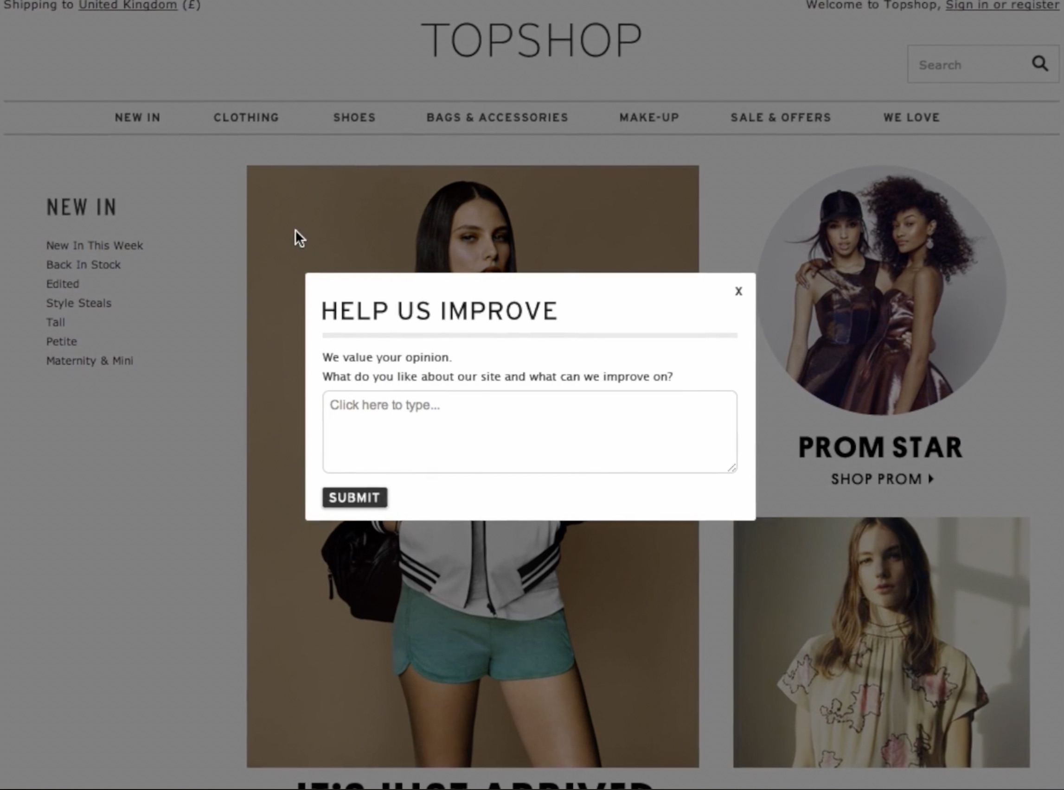
The intercept: capturing the why in-session
SAY · SURVEY
Instrument
Qubit Visitor Opinion, on-site intercept. Qualtrics today: Website / App Insights.
Trigger
Fired in-session at the point of friction and on exit intent. Qualtrics today: intercept action logic.
Format
Open-ended — the hypothesis space was unknown; closed options would only echo our guesses.
Targeting
Who, when, how often — frequency caps so heavy visitors aren’t oversampled. Qualtrics today: embedded data + XM Directory rules.
The actual instrument, live on Topshop: an open-text Visitor Opinion intercept — in-session, unprompted, no checkboxes to bias the answer.
The recurring theme: users struggled to find and use the search bar — a low-contrast element with no affordance saying “type here.” A causal hypothesis analytics could not produce.
5 / 14
Notes:
TIMING 4:30-7:00 — your LONGEST beat; this is the JD’s core skill and you now have the receipt on screen. Gesture at it: ‘This is the actual instrument, live on Topshop — open text box, in-session, no multiple choice.’ Then defend each design choice from the left: WHY in-session/exit-triggered (catch users mid-friction; recall decays within minutes), WHY open-ended (checkboxes would just feed users my own biases back), WHY targeting logic (‘who sees it, when, how often, determined whether the signal was usable at all’ — strict frequency capping so we weren’t hearing only from a loud minority). Say one Qualtrics translation out loud: ‘the architecture maps one-to-one — action logic for the trigger, embedded data for context, XM Directory for frequency rules.’ THEN THE VERBATIM MOMENT: ‘And what came back was consistent — people were effectively asking us, where is the search bar?’ PAUSE for a beat. LIKELY PROBES: response volume and coding method (have your real numbers ready); vocal-minority risk — answer: theme recurrence + convergence with the behavioural anomaly + we treated it as a hypothesis to TEST, not a conclusion.

Slide 6
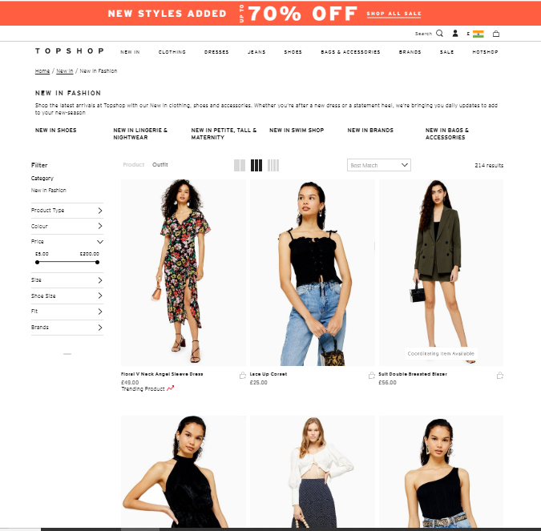
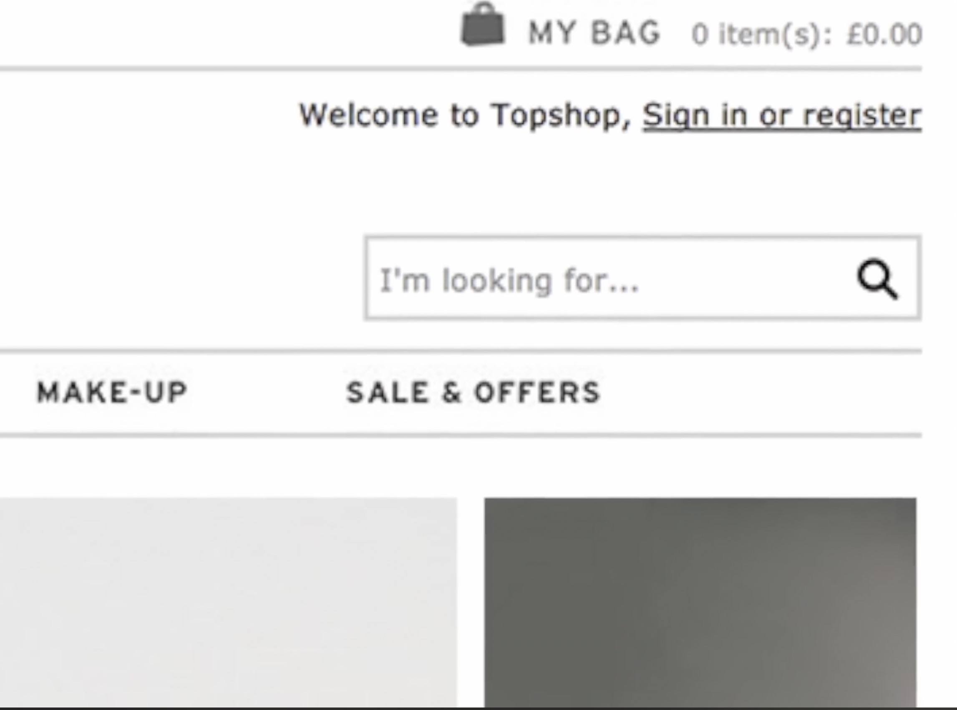
The surface in question
The header, as users met it
The shipped treatment (Variant D)
Search sits in the header competing with promo banners, nav, account, and bag — a text element among many
6 / 14
Notes:
TIMING ~40 seconds. Left: ‘Here’s the header as users actually met it — search is one quiet text element competing with promo banners, navigation, account and bag.’ Right: ‘And here is what shipped — Variant D. A defined field boundary, and concise invitation copy. That is the entire intervention: the border does the work of saying ‘this is a thing you type into.’’ IMPORTANT — be precise that the right image is the WINNING treatment, not the before-state; if you present it as ‘before’ and a panelist looks closely at the border, you lose credibility for free. The honest before/after framing is stronger anyway: it lets the panel SEE the mechanism you isolated.

Slide 7
Triangulation: neither signal alone justified action
SAY — the diagnostic
DO — the business case
“I can't find the search bar” — a mechanism. But alone, it's an anecdote that loses roadmap arguments to flashier ideas.
+
Search users convert ~10× — a prize. But alone, it's a problem with no actionable fix attached.
A sized, mechanism-specific, testable hypothesis
“Search visibility and affordance suppress adoption; fixing them will lift conversion — and the lift is worth engineering time, because the affected behavior converts at 10×.”
7 / 14
Notes:
TIMING 7:00-8:30. The thesis slide — slow down. Script: 'The intercept gave us the diagnostic; the analytics gave us the business case. Neither alone would have justified the work. Feedback without the 10x number is an anecdote. The 10x number without feedback is a mystery. Joined, they made testing search the OBVIOUS next move — and that's the exact integration loop this role runs between Qualtrics and Glassbox.' One breath, then forward. If a panelist asks 'why not just ship the border, it's cheap?' — perfect setup for the next slide: because 'cheap to ship' isn't 'free to be wrong': a sitewide change on the highest-intent surface, and two DIFFERENT candidate mechanisms with different fixes.

Slide 8
Design the inference, then run the test
TEST · CAUSAL
Two mechanisms from feedback → 2×2 factorial structure (+ control)
Pre-committed decision rules
Even randomized split across all five cells — assignment by visitor, consistent within session
Primary metric: conversion — chosen because the 10× stakes made it directly revenue-bearing
Run to statistical significance BEFORE any rollout conversation — evidence, not opinion, goes to IT prioritization
Factorial structure means the winner is attributable to a mechanism — not to novelty
A — Copy change only
B — Border only
Invitation hypothesis, isolated
Visibility hypothesis, isolated
C — Border + expanded copy
D — Border + concise copy
Combined effect
Combined, minimal ★ winner
vs. CONTROL — existing design, evenly split traffic
Today I'd add: pre-registered duration (no peeking), and explicit guardrail metrics — abandonment, complaint rate via a light intercept.
8 / 14
Notes:
TIMING 8:30-10:30. This is your experimental-design credibility slide. Narrate the grid: 'The feedback pointed at two candidate mechanisms — visibility and invitation. Rather than betting on either, four variants isolated and combined them, so whatever won would tell us WHICH mechanism was binding.' Terminology, ready if probed: 'Four cells forming a factorial structure on two factors, run and analyzed as A/B/n against control. With today's traffic I'd run it as a formal MVT and estimate the border-by-copy interaction directly.' On the 'today I'd add' box — say it proactively; it shows growth, and it preempts the peeking question. If asked sample size: e-commerce traffic made power a non-issue; the binding constraint was run-length to cover weekly cycles, not n.

Slide 9
Statistical validation: signal, not noise
TEST · CAUSAL
Variant
Mechanism tested
Conversions / visitors
CR
Rel. uplift
Significant?
Control
Existing UI — no border, default copy
13,020 / 620,000
2.10%
baseline
—
A — Copy only
“Invitation”, isolated
13,082 / 620,000
2.11%
+0.5%
No — n.s. (p > .05)
B — Border only
“Visibility”, isolated
13,640 / 620,000
2.20%
+4.8%
Yes (p < .05)
C — Border + long copy
Combined, expanded
13,516 / 620,000
2.18%
+3.8%
Yes (p < .05)
D — Border + concise copy
Combined, minimal
13,776 / 620,000
2.22%
+5.8%
Yes — winner
Pre-committed inference: two-proportion Z-test per cell against control, 95% threshold fixed before launch — no peeking, no early stopping.
The attribution readout: A flatlined against control; every bordered cell jumped. Visibility carried the effect — invitation never mattered.
Representative figures, reconstructed to be consistent with the reported +5.8% uplift and the ~3.1M-visitor test scale shown on the platform dashboard; raw exports remain internal to Qubit / Arcadia. Z = (CRᵥ − CRᴄ) / SE, SE = √( p̄(1−p̄)(1/nᴄ + 1/nᵥ) ).
9 / 14
Notes:
TIMING 10:30-12:00. Do NOT read the table or the formula — they are on screen so you don’t have to. Talk strategy: ‘Anyone can run a test and pick the tallest bar. I needed signal, not noise. Baseline conversion sat around 2.1%. Variant A — copy only — flatlined, statistically indistinguishable from control. Every variant that introduced the border jumped significantly. D landed at 2.22%: a 5.8% relative uplift that comfortably cleared the 95% threshold we committed to before launch. That fractional difference looks tiny on a slide; at Topshop’s volume it is substantial annualised revenue.’ THE HONESTY LINE (memorise, deliver unprompted): ‘I don’t have the raw Qubit export from years ago — these are representative figures reconstructed to match the validated 5.8% result and the 3.1M-visitor scale you’ll see on the platform dashboard in a moment.’ Said matter-of-factly it reads as rigour; panels know nobody keeps raw exports. PROBES: multiple comparisons — four tests at .05 inflates false-positive risk; today I’d correct or model the factorial directly. Relative vs absolute — +0.12pp absolute on a 2.10% base = +5.8% relative; be fluent in both. Why conversion not RPV — conversion was the pre-registered primary; Qubit’s own published Topshop US case showed a test flat on conversion but +4.5% on revenue, which is exactly why metric choice precedes analysis.

Slide 10
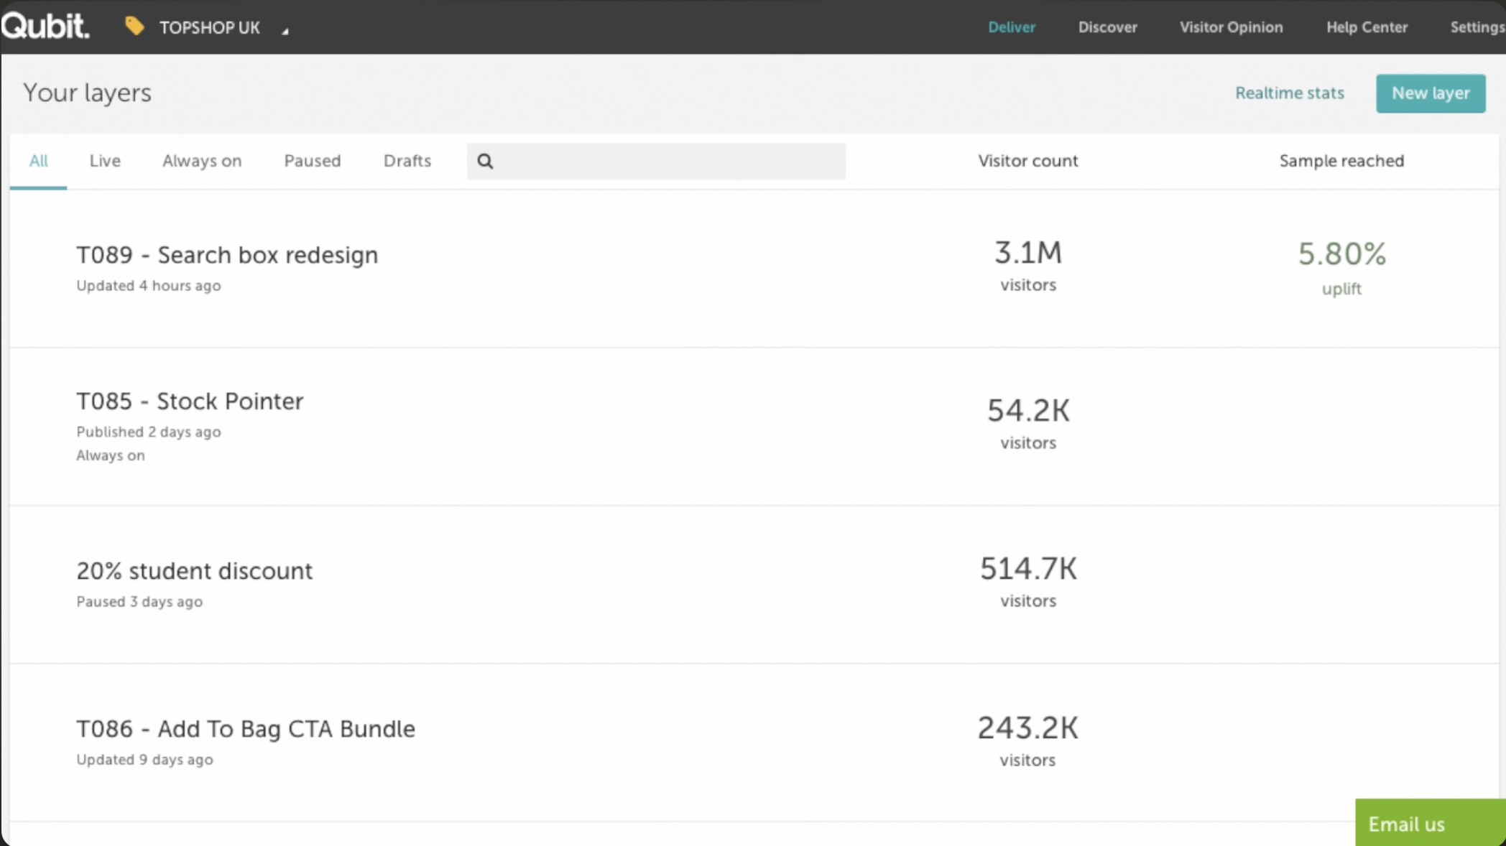
Results: the platform receipt
+5.8%
conversion uplift on 3.1M visitors — Variant D, shipped sitewide
Border carried the effect → visibility was the binding constraint
Copy contributed nothing → the equally “obvious” rival hypothesis lost
Generalisable design constraint: every low-affordance element became a suspect
Qubit experimentation dashboard — T089 Search box redesign: 3.1M visitors, 5.80% uplift. T085 Stock Pointer and T086 Add-to-Bag CTA below it are the same loop, running on.
The loop compounds: the same intercept → hypothesis → test cycle across product-page micro-changes added 9–11% cumulative — tracked as cumulative RPV, because sequential results don’t naively sum.
10 / 14
Notes:
TIMING 12:00-13:00. This is your evidence anchor. Gesture at the dashboard: ‘This is the actual platform — T089, search box redesign: three point one million visitors, five point eight percent uplift. And look at what sits directly beneath it — the Stock Pointer and the Add-to-Bag CTA bundle. That is the compounding programme, live on the same screen.’ Then attribution, briefly: border carried it, copy didn’t, visibility was the disease — and that generalised into a design constraint for future UI work. The dashboard also shields the reconstructed table one slide back: the headline number and the scale are verifiably real, only the per-cell fractions are representative. If asked for a CI on 5.8%: ‘reported at platform significance thresholds at the time; today I’d lead with the interval and the revenue value of its lower bound.’

Slide 11
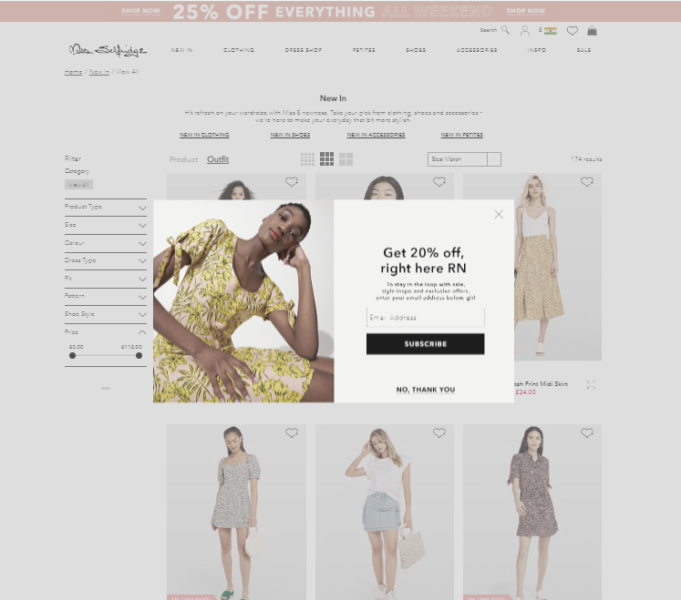
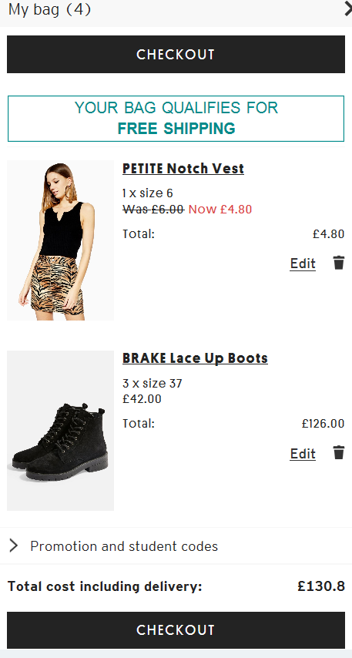
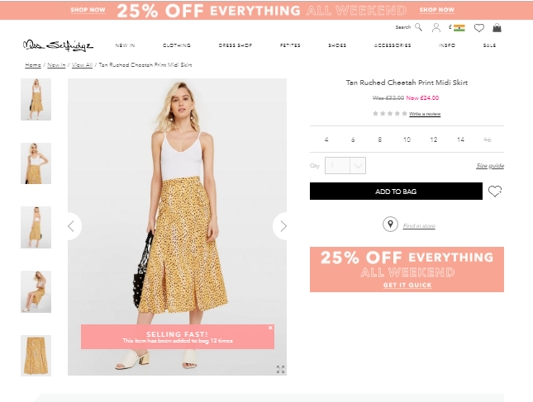
The compounding loop, visually
Signup pop-up — targeted by visitor state, capped by frequency rules; the same targeting-logic muscle as the intercepts
Product page micro-changes: “selling fast” urgency + “only 1 left” stock signal — each one tested, not assumed
Recently-viewed slider — recovery of intent
11 / 14
Notes:
TIMING ~30 seconds. 'These are some of the actual micro-changes the loop produced — urgency messaging, stock signals, recently-viewed recovery, state-targeted pop-ups. Individually tiny; together, that nine-to-eleven percent. And notice the pop-up caption — targeting and frequency logic is the same muscle whether you're serving a marketing message or an intercept survey.' That last line quietly re-links to the JD. Move on briskly — this is a texture slide, not an argument slide.

Slide 12
Limitations — and what I'd do differently today
Intercept sampling skews engaged
Manual open-end coding
Single primary metric
Exit intercepts oversample invested users; the silently-bouncing majority is underheard.
Theming hundreds of verbatims by hand is slow and subjectivity-prone.
Conversion-only optimization can hide experience costs elsewhere.
Today: frequency caps + quota targeting in Qualtrics; weight responses by session-frequency from behavioral data.
Today: NLP-assisted clustering for scale, human review for validity — the exact hybrid I build at ABIM.
Today: explicit guardrails — abandonment, rage-clicks, complaint-rate intercept — defined before launch.
12 / 14
Notes:
TIMING 13:00-14:00. Volunteering limitations BEFORE Q&A is the highest-trust move in a research presentation — it converts your weakest surface into evidence of rigor. One sentence per card, teal line = the upgrade. Card 1 doubles as Qualtrics-fluency proof (frequency rules, quotas, weighting). Card 2 quietly bridges to your ABIM NLP work — one clause, don't detour. Card 3 preempts the single-metric critique. If a panelist adds a limitation you didn't list (e.g., seasonality): 'agreed — run-length covering weekly cycles mitigated but wouldn't eliminate it; a holdback at rollout is the stronger control' — never defensive, always additive.

Slide 13
Does the discipline transfer? B2B, small-N, same rigor
John Deere — longitudinal usability study, enterprise migration
60 → 85.6
N=4 + N=40
Novelty handled
SUS across the study window — vs. industry average 68, 'excellent' threshold 80
power users in longitudinal depth, triangulated with an org-wide survey
familiarization window before measuring — day-one scores measure the learning curve, not the product
Same loop, your stack
Qubit behavioral analytics
→
Glassbox: funnels, struggle detection, session replay
Qubit Visitor Opinion intercepts
→
Qualtrics: intercepts, embedded data, XM Directory, dashboards
Qubit experimentation
→
Your testing platform + my analysis layer (Python/R)
13 / 14
Notes:
TIMING 14:00-14:45 — ninety seconds, strict. Script: 'Everything so far was B2C at scale. The same discipline runs in the opposite regime — B2B enterprise, four power users, where rigor means design choices, not big n: longitudinal SUS, benchmarked against industry norms, novelty effects handled with a familiarization window. Small N required DIFFERENT rigor, not less.' Then the mapping table, one breath per row — you're ending the talk standing inside their toolchain. If they want more Deere detail, that's what Q&A is for; do not let this slide eat the close.

Slide 14
The loop I'd bring to this role
GLASSBOX
behavioral data finds the where — funnels, struggle, replay
QUALTRICS
intercepts find the why — triggers, embedded data, directories
EXPERIMENTS
prove the fix — designed inference, practical significance
DASHBOARDS
keep it honest — tracked metrics, compounding wins
Numbers tell you the scale. Feedback tells you the cause. Experiments tell you the truth.
Notes:
TIMING 14:45-15:00. Return to slide 1's structure — now wearing THEIR tools. Script: 'This loop — behavioral data to locate, intercepts to diagnose, experiments to prove, dashboards to keep honest — is what I ran at Arcadia, and it's what I'd run here between Glassbox and Qualtrics from day one.' Close on the thesis line, then stop talking. Silence invites the first question; the first question is where you win the room.

